Slide 2
Spatialisation des données d’entrée
Extraits de la thèse de S. Ly (2012)

Slide 3
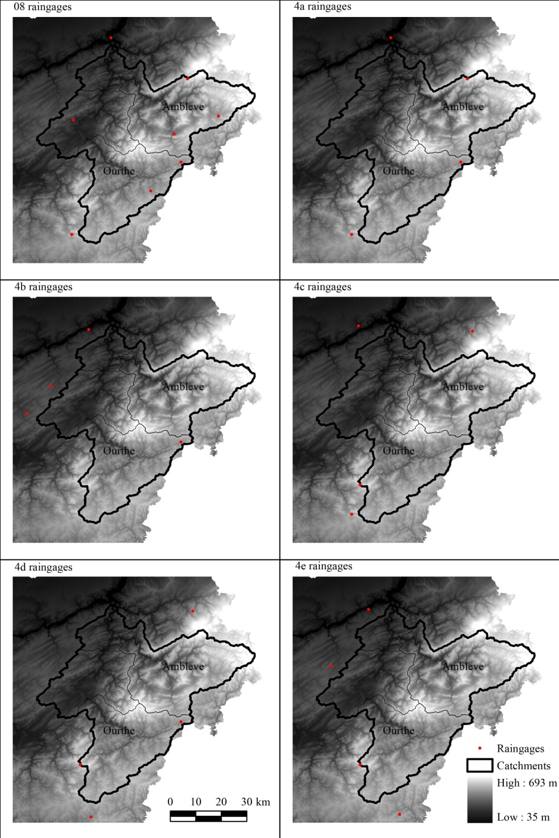
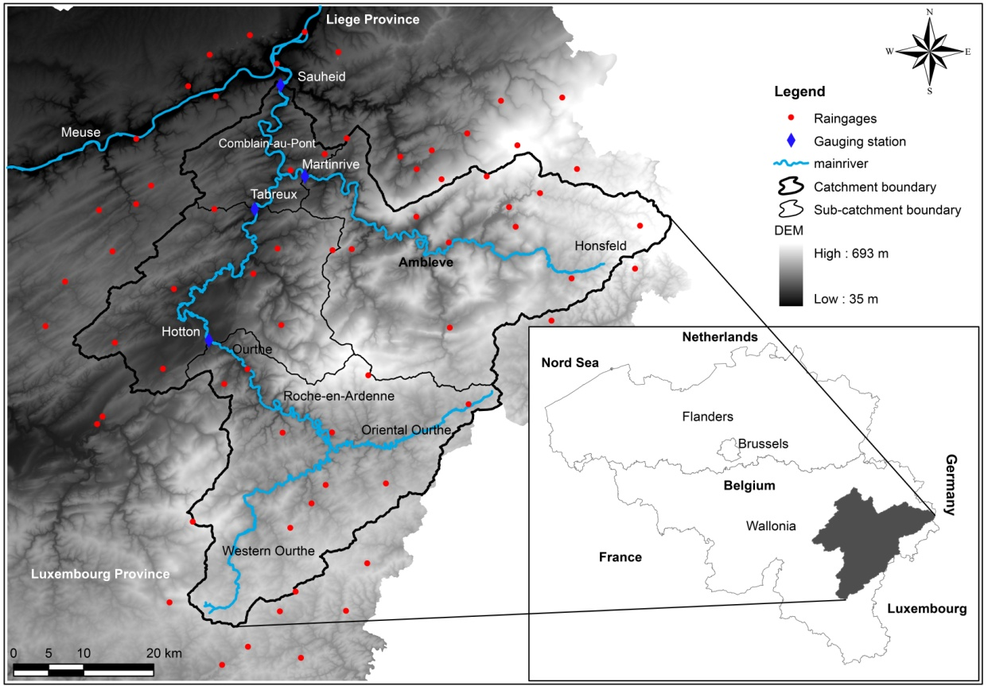
4. Impacts of geostatistical algorithms on daily extreme rainfall
4.2. Materials and methods (Rainfall scenarios)
Different degenerated densities and spatial locations of raingages used for interpolations
Walloon region, Belgium
70 rain gauges surrounding (daily data of 30 years);
Hilly landscape: elevation from 35 to 693m;
Ourthe & Ambleve rivers: tributaries of Meuse River;
Area: 2908 Km².

Slide 4


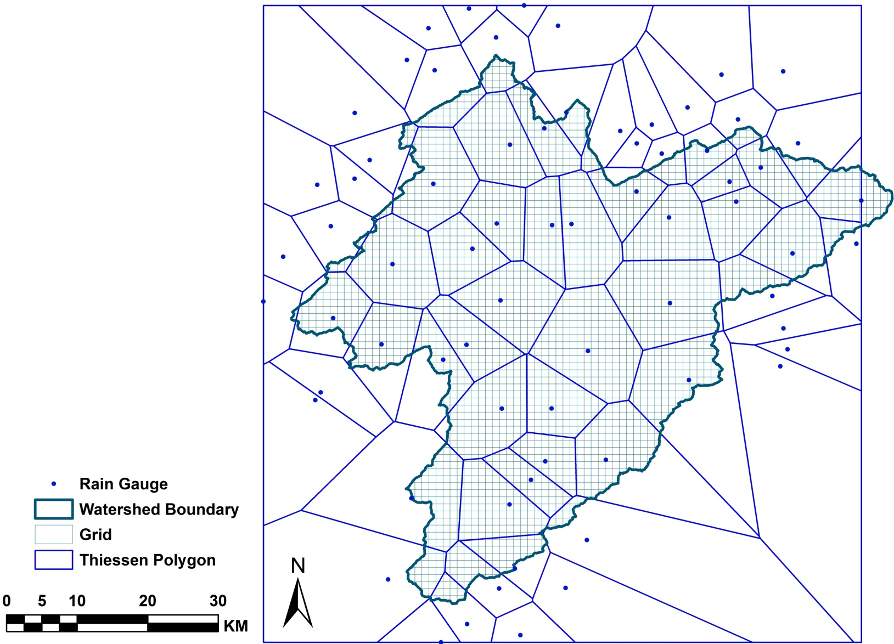
Spatial Interpolation Procedures
Thiessen polygons: THI (deterministic)
- Simple & straightforward;
- Give the value of the closest rain gauges;
- Discontinuities at the borders of the polygons.

Slide 5
Krigeage
Méthode d’interpolation spatiale entre des données ponctuelles connues
Estimation d’une fonction F(x) où x = (x,y) en un point X_{p} du plan à partir de valeurs connues de F en un certain nombre de points environnants x_{i}
Reste à déterminer les pondérations W_{i}

Slide 6
Pondérations W_{i}
Différentes possibilités
Fct inverse de la distance
Prise en compte des similitudes entre valeurs environnantes connues : Krigeage
Utilisation du « variogramme », fonction construite sur base des valeurs ponctuelles connues et de leur position dans le plan
Méthode démontrée
plus performante que l’interpolation linéaire à l’intérieur des points connus et
Permettant une première estimation en dehors du domaine couvert par les points connus.
Mais selon les techniques, l’interpolation peut fortement dévier des gammes de valeur « plausibles »

Slide 7
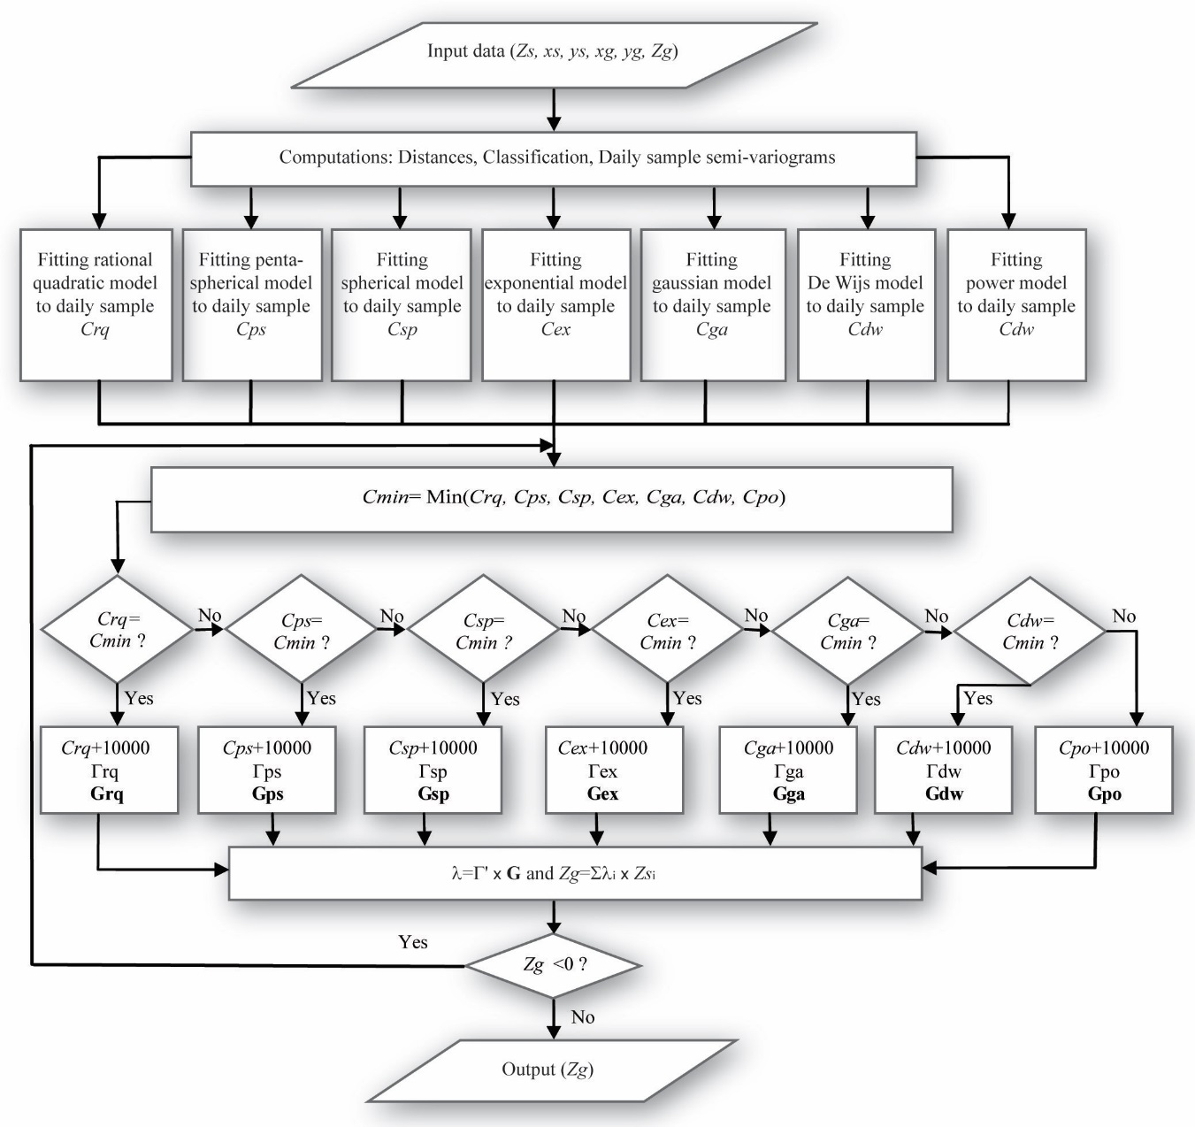
4. Impacts of geostatistical algorithms on daily extreme rainfall
4.2. Materials and methods (Geostatistical interpolation methods)
Four versions of Geostatistics:
Ordinary Kriging (ORK)
Universal Kriging (UNK)
Kriging with External Drift (KED)
Ordinary Cokriging (OCK)

Slide 8
Spatial Interpolation Procedures
Zg: interpolated rainfall dept at grids;
g= 1, 2, …ng where ng total number of grids ;
ns: total number of rain gauges;
Zs: measured rainfall dept at rain gauges;
λ: weight;
D_{ij}: distance between rain gauge i and grid j ;
d: usually equal to 2
γ: semi-variogramme values for different lags
μ: Lagrange parameter accounting for the constraint on the weights;
Inverse Distance Weighted: IDW
Ordinary Kriging: ORK
Universal Kriging &
Kriging with an External Drift
f: deterministic functions for local trend and external drift

Slide 9
Spatial Interpolation Procedures
Zg: interpolated rainfall dept at grids;
g= 1, 2, …ng where ng total number of grids ;
ns: total number of rain gauges;
Zs: measured rainfall dept at rain gauges;
λ: rainfall weight (primary data);
γ: semi-variogramme or cross-variogramme for different lags;
μ: Lagrange parameters accounting for constraint on different weights
Ys: secondary variable at rain gauges;
α : secondary data weight
Ordinary Cokriging: OCK (geostatistics)

Slide 10
Spatial Interpolation Procedures
N(h): the number of pairs of rain gauge locations a vector h apart;
Zs: measured rainfall dept at rain gauges;
- These seven models always combine a nugget effect;
Semi-variogramme
+ Experimental semi-variogramme:
+ Seven different permissible semi-variogramme models:
- Logarithmic model:
- Power model:
- Exponential model:
- Gaussian model:

Slide 11
Spatial Interpolation Procedures
- Fitting variogramme models to an experimental variogramme are based on Cressie’s Approximate Weighted Least Squares Criterion
- Lowest of least square coefficient
- Positive kriged values
Semi-variogramme
+ Seven different permissible semi-variogramme models:
- Rational Quadratic model:
- Spherical model:
- Penta-spherical model:

Slide 12
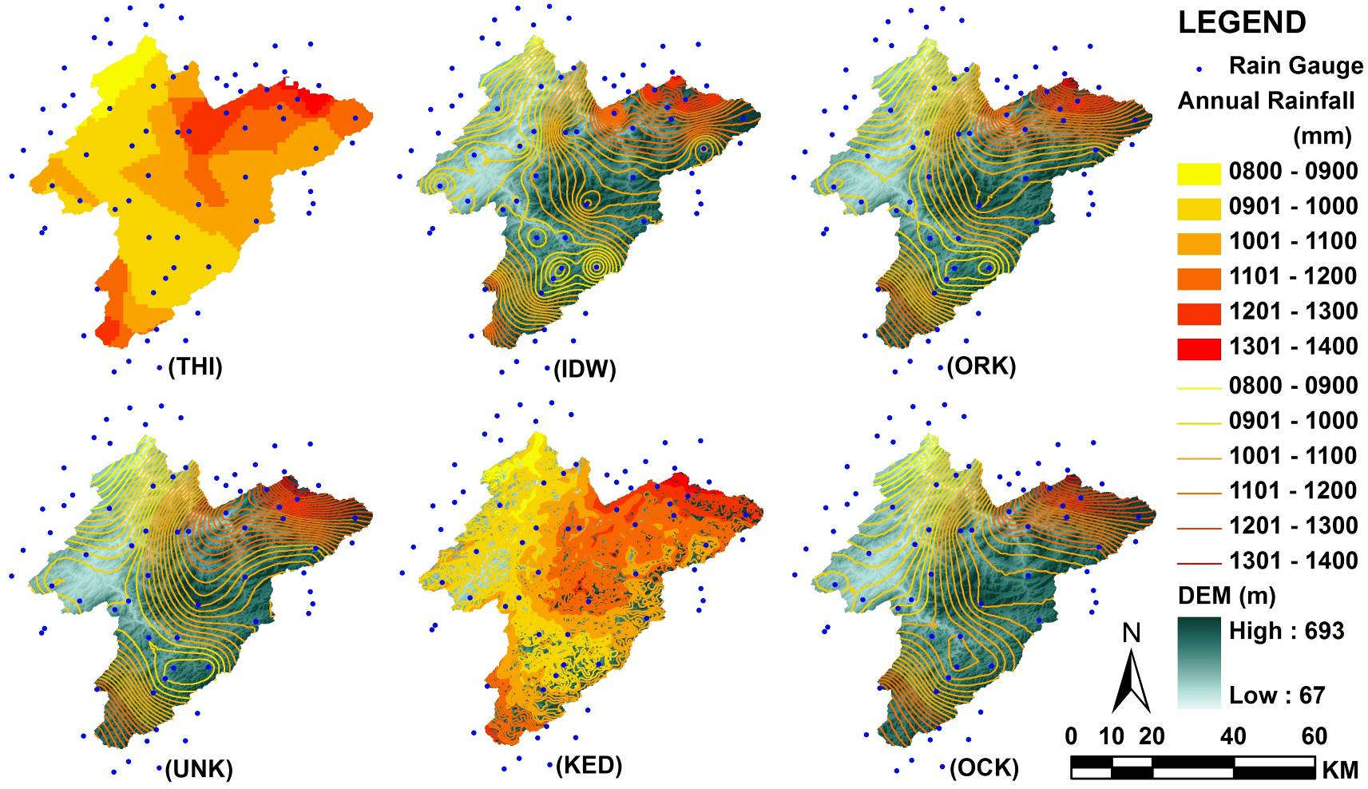
Comparison: Annually Areal Mean Rainfall, case 1
AMR=1045
AMR=1044
AMR=1045
AMR=1052
AMR=1063
AMR=1049
AMR= Areal Mean Rainfall in the basin (mm)
Notes:
There are discontinuities for THI. We can see there are spatially difference among these methods
KED is significantly related to elevation and yields highest of total rainfall in the basin.

Slide 13
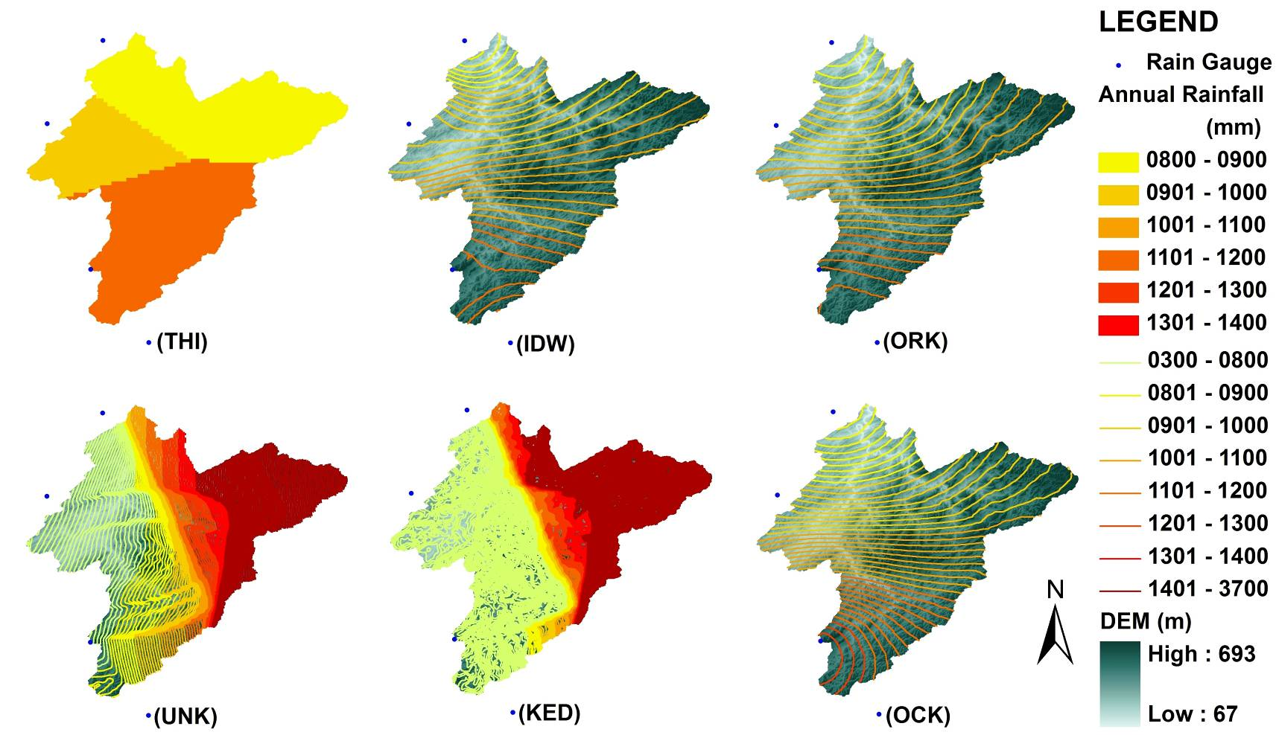
Comparison: Annually Areal Mean Rainfall, case 4
AMR=990
AMR=1025
AMR=1026
AMR=1137
AMR=1199
AMR=1021
AMR= Areal Mean Rainfall in the basin (mm)
Notes:
This 4 stations contain all daily data from 1976 to 2005. IDW, ORK and OCK yield nearly the same distribution of interpolated rainfall. UNK and KED give surprising results. This may be due to correlation between coordinate and rainfall values is not good. Big part of the basin has very high rainfall, in contrary, other part has very low rainfall. That’s why the areal mean rainfall in the basin is not much higher that the previous cases.

Slide 14
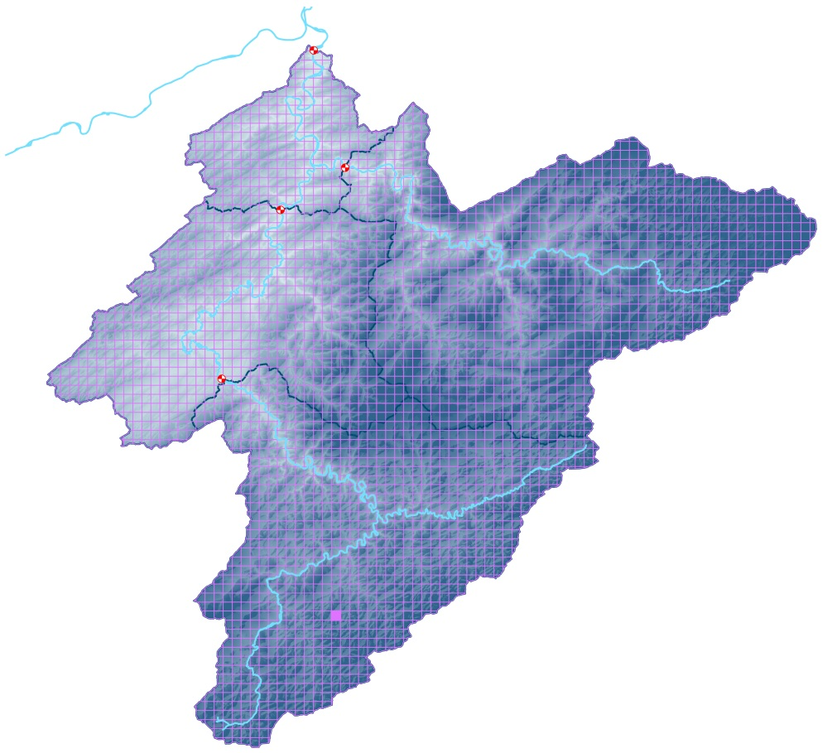
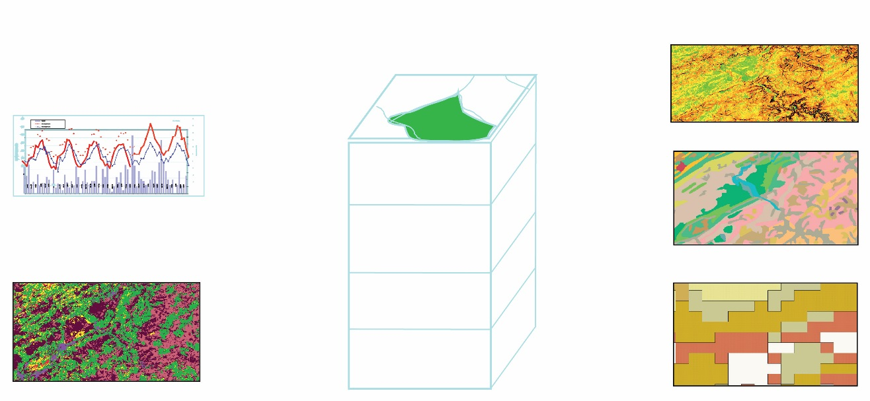
5. Validation of geostatistical methods: modelling approach
5.2. Materials and methods
Sauhied
Meuse
Martinrive
EPIC-GRID
Catchment modelling,
Soils and vadose zone
Ambleve
Tabreux
Ourthe
Hotton
River network
GRID: 1 km²
DEM
Climatic data
A
B
B
C
Soils
In each grid: weighting of different components
Land use, crop growth
Agricultural practices
Geology

Slide 15
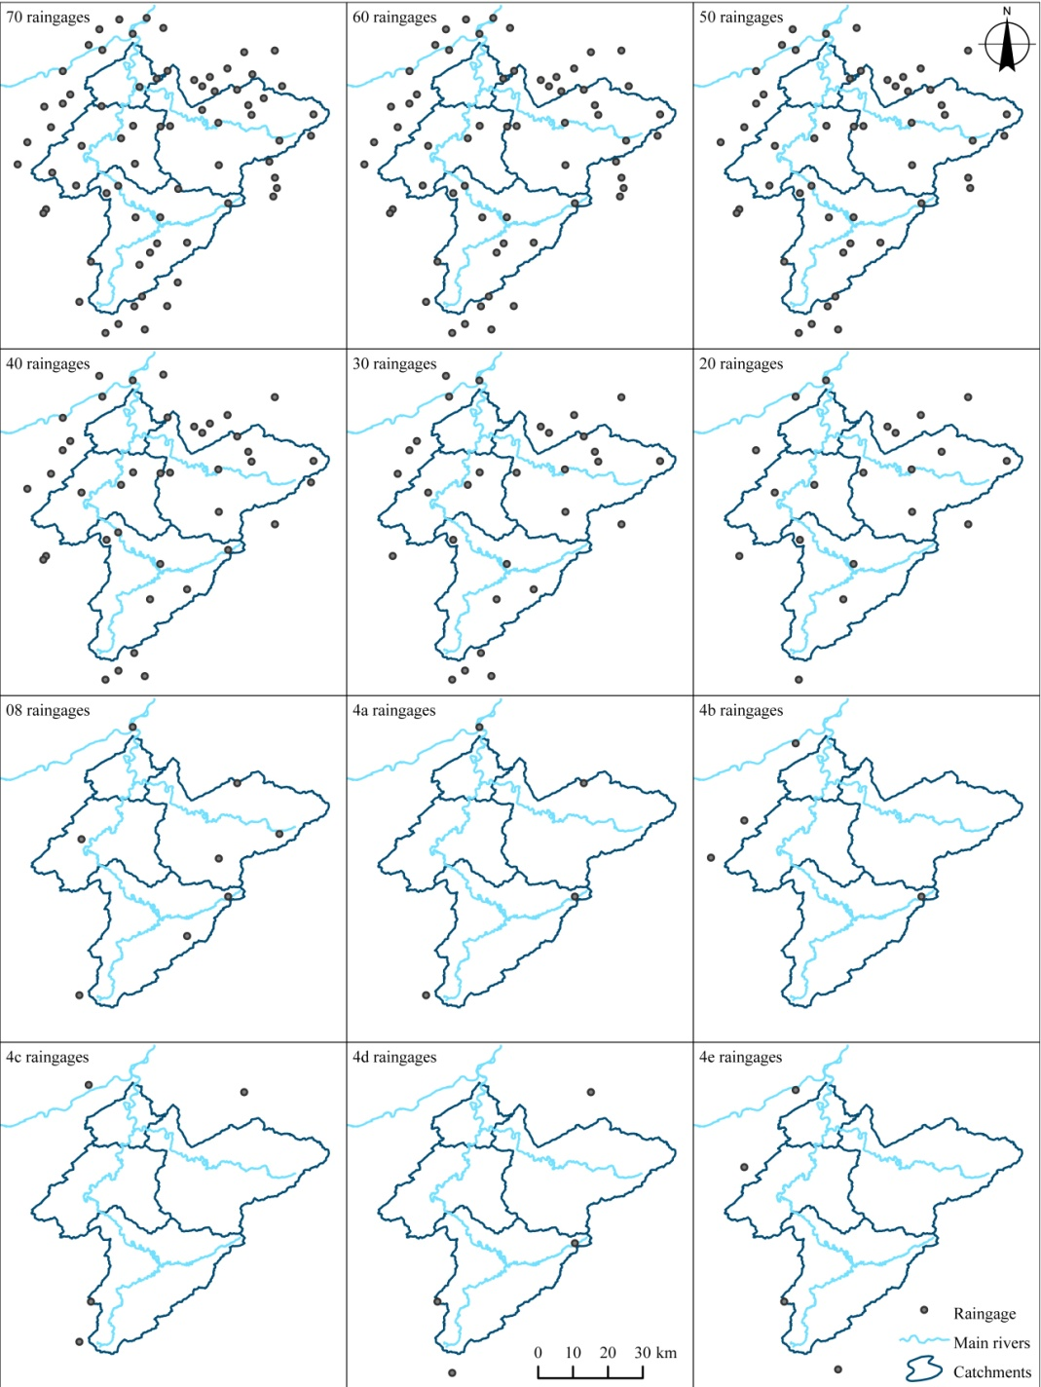
5. Validation of geostatistical methods: modelling approach
5.2. Materials and methods
Different degenerated densities and spatial locations of raingages used for geostatistical interpolations of rainfall

Slide 16
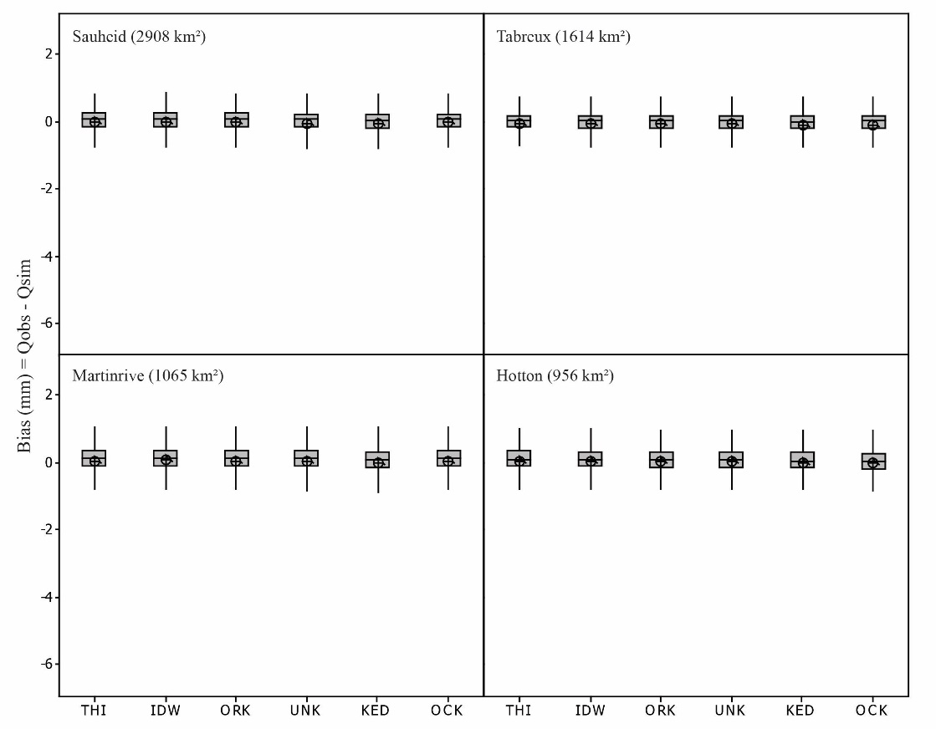
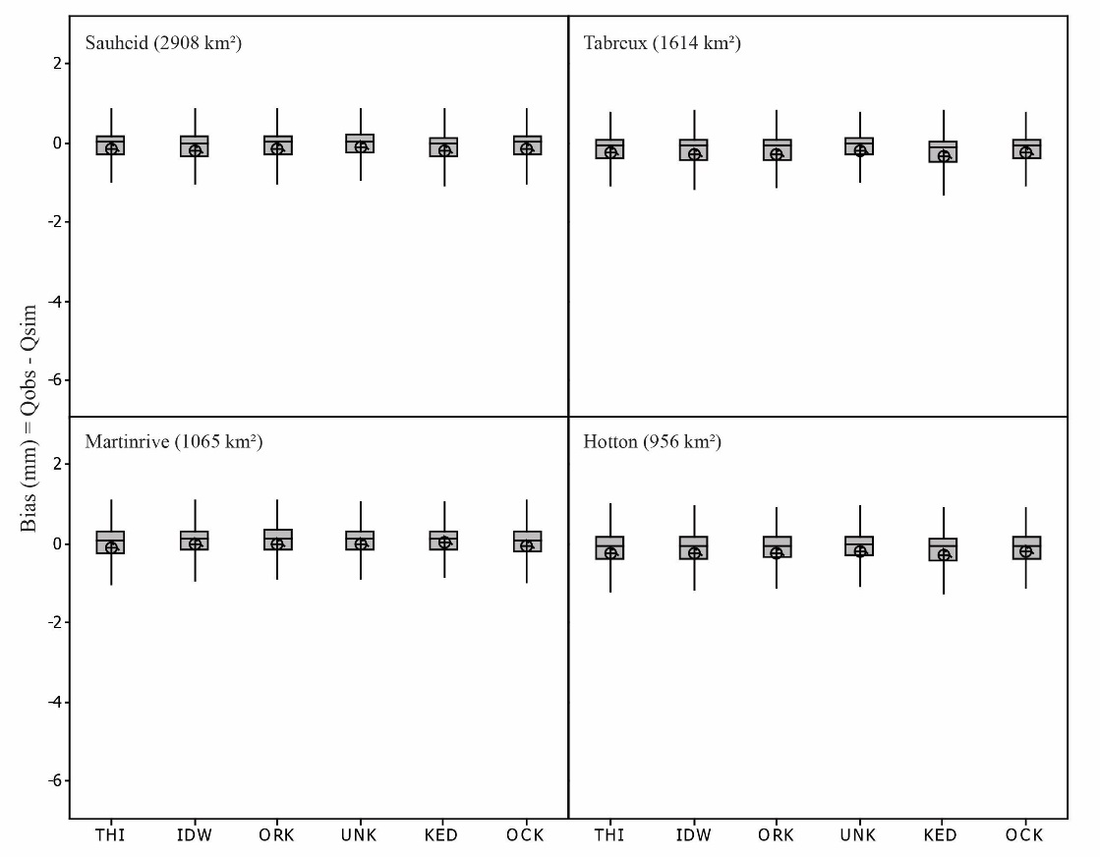
5. Validation of geostatistical methods: modelling approach
5.3. Results and discussion
70 raingages
4a raingages

Slide 17
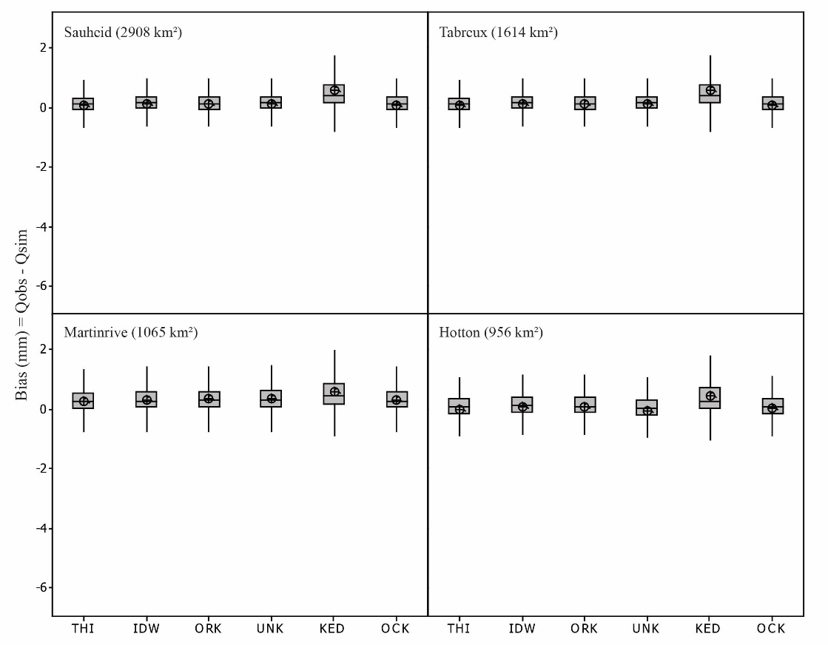
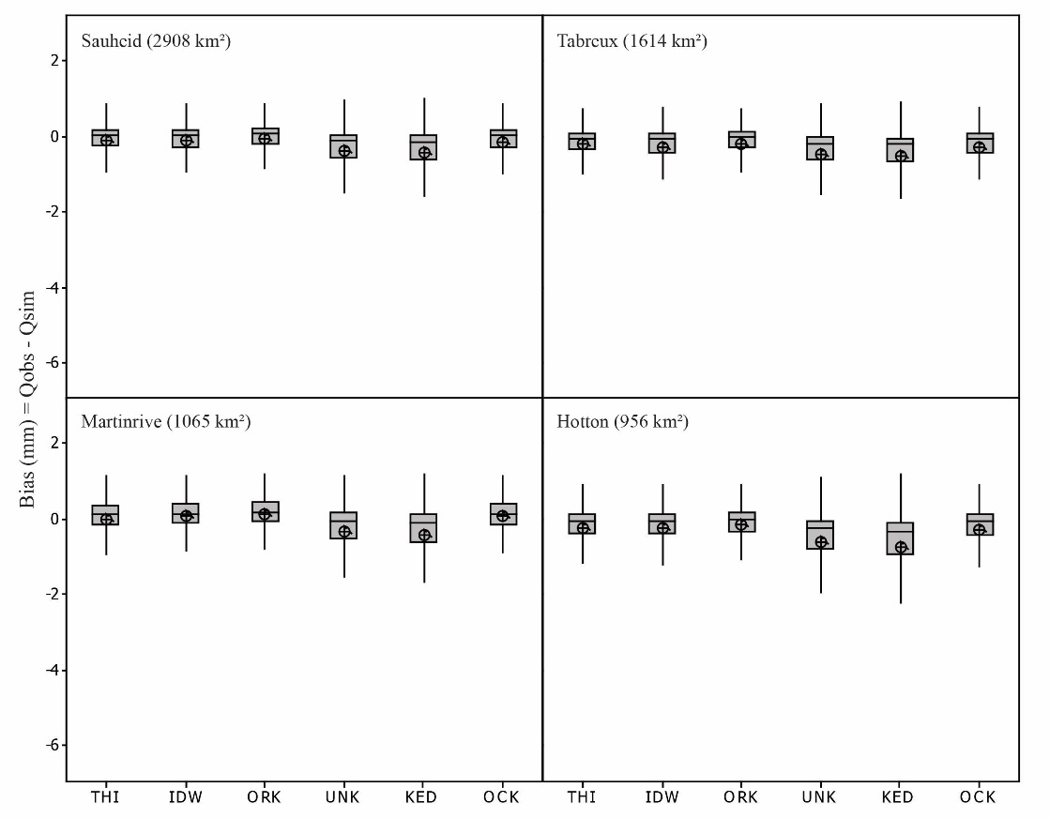
5. Validation of geostatistical methods: modelling approach
5.3. Results and discussion
4b raingages
4c raingages

Slide 18
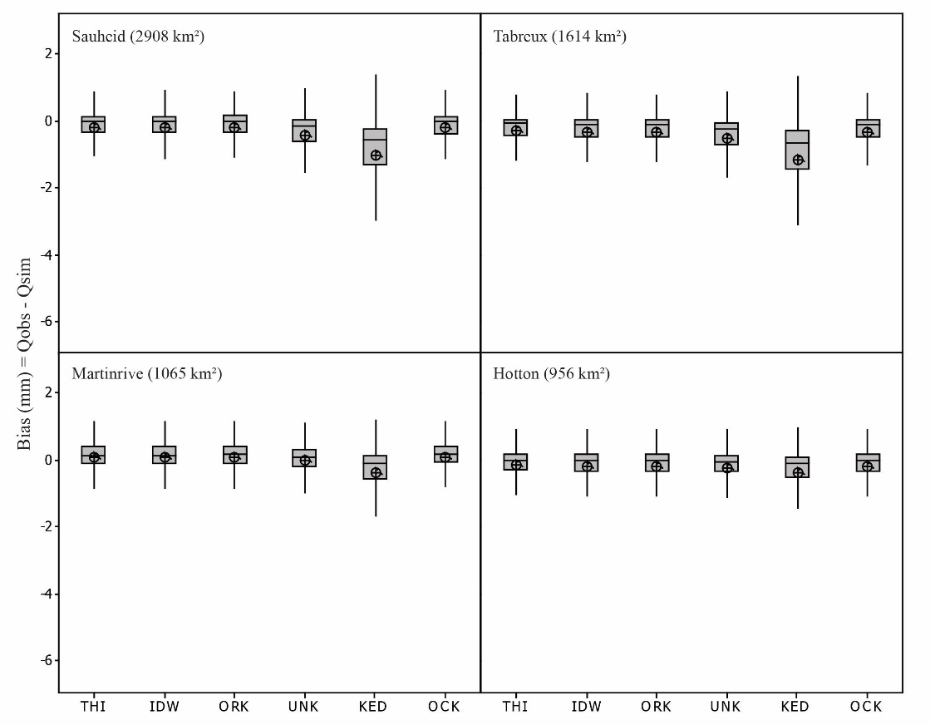
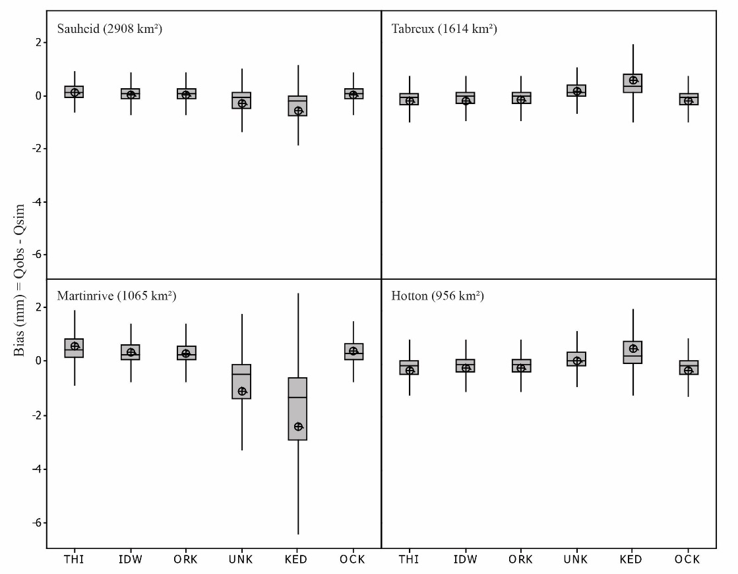
5. Validation of geostatistical methods: modelling approach
5.3. Results and discussion
4d raingages
4e raingages

Slide 19
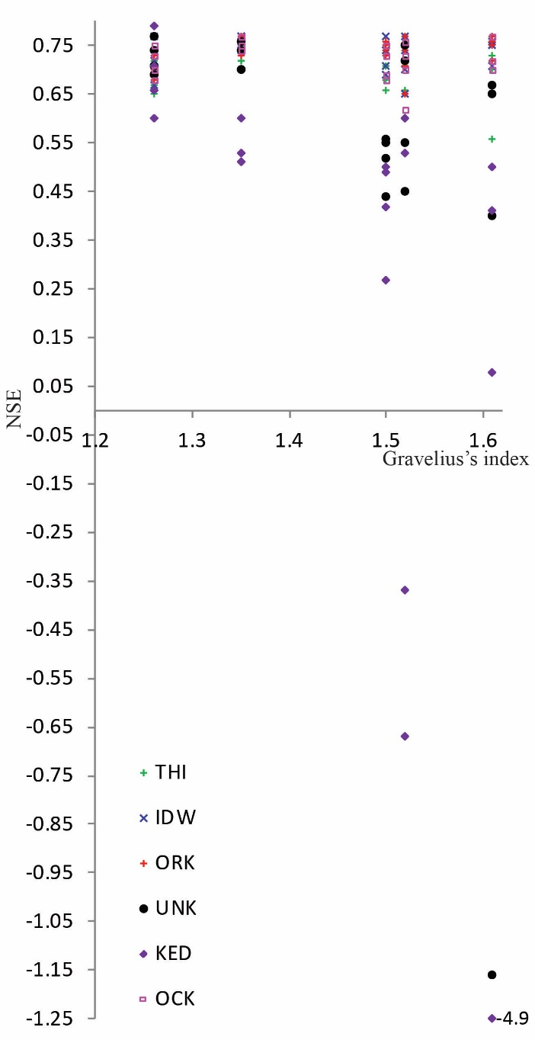
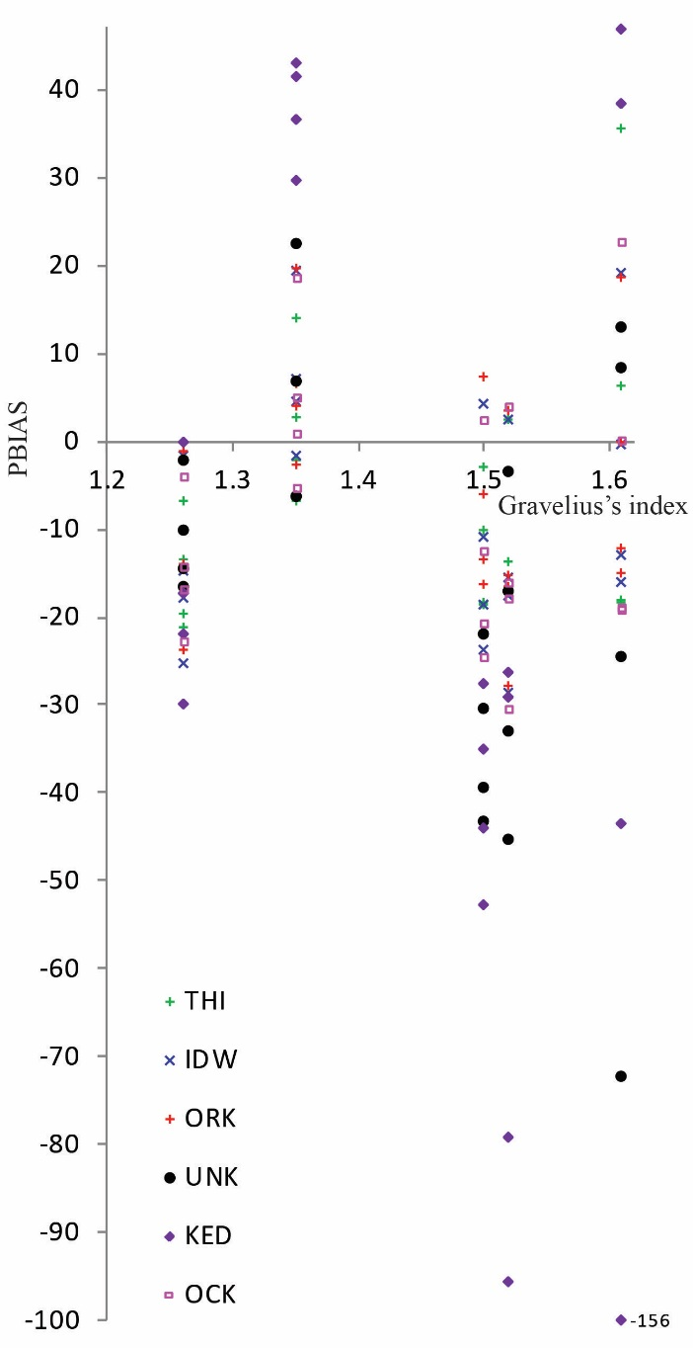
5. Validation of geostatistical methods: modelling approach
5.3. Results and discussion
The four raingages of the different positions are converted to polygon
The Gravelius’s indexes are calculated to characterise the polygon’s shape
This index is defined as the relation between the polygon perimeter and a circle perimeter having an area equivalent to that of a polygon
Evolution of simulation performances according to raingage position

Slide 20
5. Validation of geostatistical methods: modelling approach
5.4. Conclusions
Flow simulation over 30-year period shows that runoff predictions of EPIC-GRID generated by different rainfall interpolations are accurate.
For very sparse raingage cases :
Raingages at low elevation part, UNK and KED provide larger error and largest error for the high elevation and small catchment;
Raingages at high elevation part, UNK and KED provide larger error and largest error for the low elevation and big catchment;
Raingages around the catchment area is considered the best raingage position;
UNK and KED methods are sensitive to raingage position and catchment characteristics;
THI is less sensitive to the raingage position than UNK and KED;
IDW, ORK and OCK can overcome all problems since they are more robust.

Slide 21
Modelling extreme discharge response to geostatistical rainfall

Slide 22
6. Extreme discharge response to geostatistical rainfall
6.1. Introduction
The chapter 5 used the interpolated rainfalls as inputs for EPIC-GRID modelling. The interpolation methods are evaluated by long-term simulation results.
This chapter presents the statistics of extreme for the discharges modelled using rainfall inputs interpolated by the interpolation approaches.
The effect of different raingage densities and particularly the raingage positions for very sparse raingage data used for rainfall interpolation, on the extreme flow is analysed.

Slide 23
6. Extreme discharge response to geostatistical rainfall
6.2. Materials and methods
Comparison between the different return period extreme discharge fitted using the observed peak discharge measured at different outlets and peak discharge modelled using rainfall interpolated by different methods
The simulated discharges are modelled using rainfall input interpolated by different interpolation methods with different density and position of raingages
The method of the annual maximum series is used
Classification of annual peak discharges from 1976 to 2005
Only one event per year is taken and served as sample distributions to estimate extreme discharge at the outlets of each sub-catchment
The annual maxima are ordered and plotted using Cunnane plotting position

Slide 24
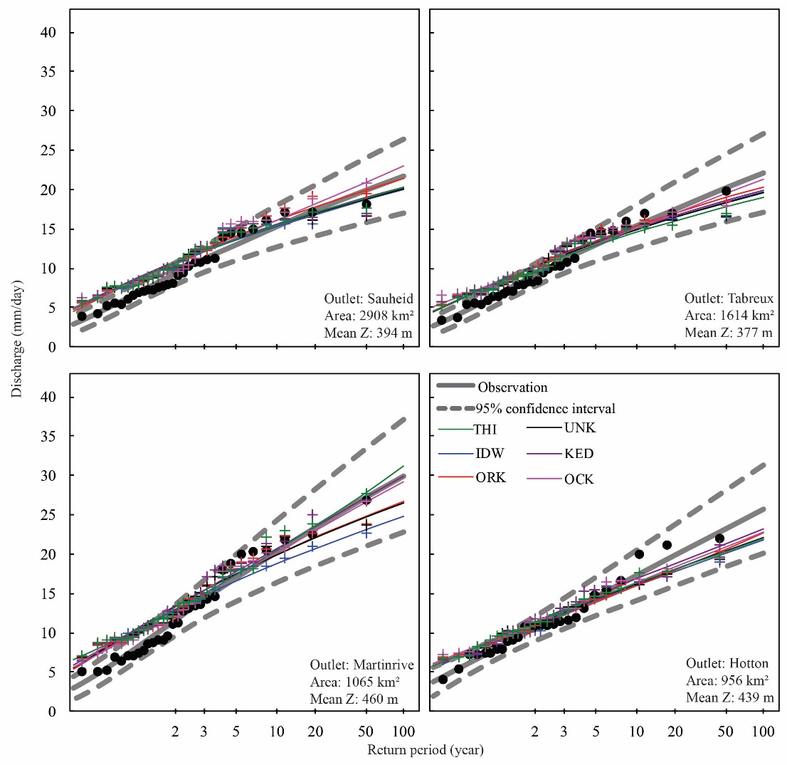
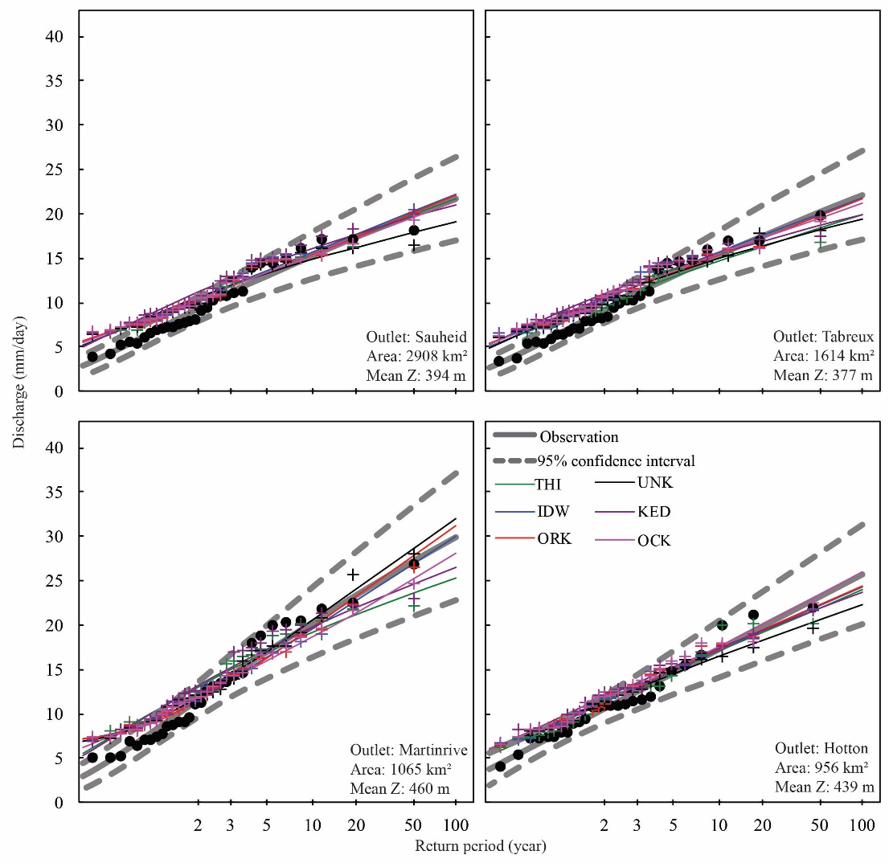
6. Extreme discharge response to geostatistical rainfall
6.3. Results and discussion
70 raingages
8 raingages

Slide 25
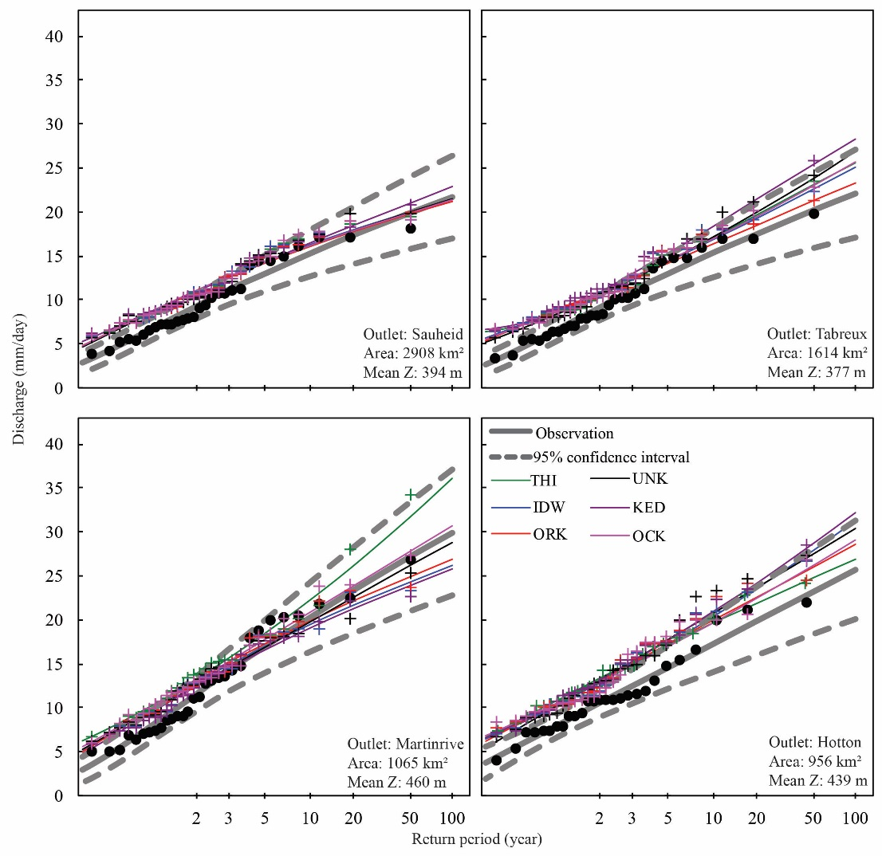
6. Extreme discharge response to geostatistical rainfall
6.3. Results and discussion
The four raingages of the different positions are converted to polygon
The Gravelius’s indexes are calculated to characterise the polygon’s shape
This index is defined as the relation between the polygon perimeter and a circle perimeter having an area equivalent to that of a polygon
4a raingages (index=1.26)

Slide 26
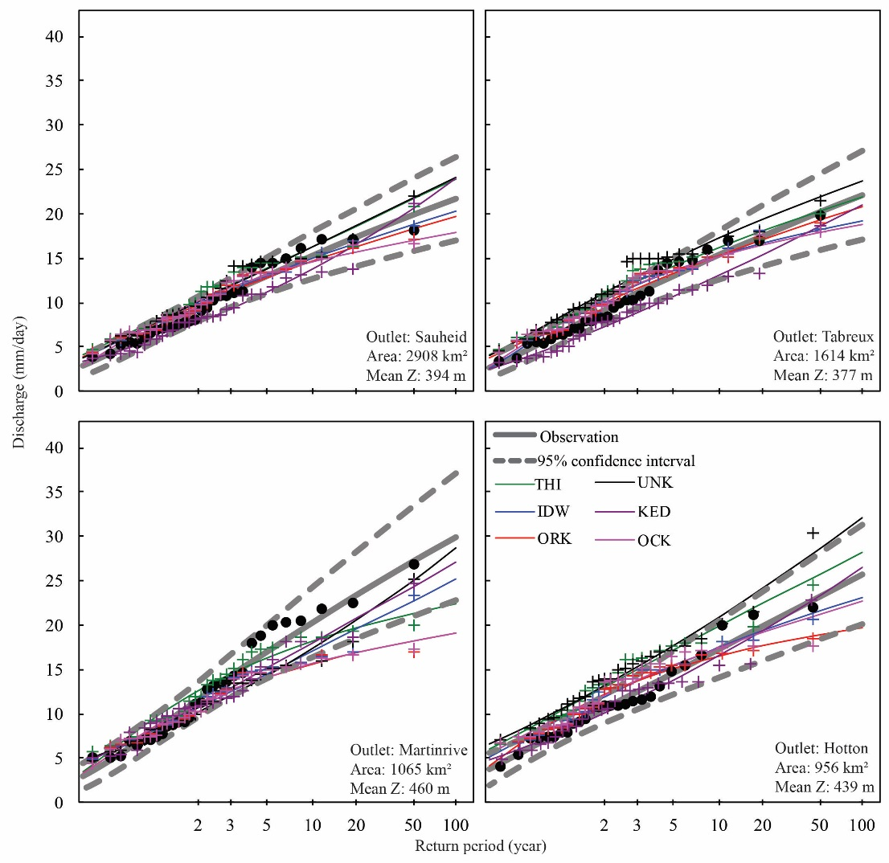
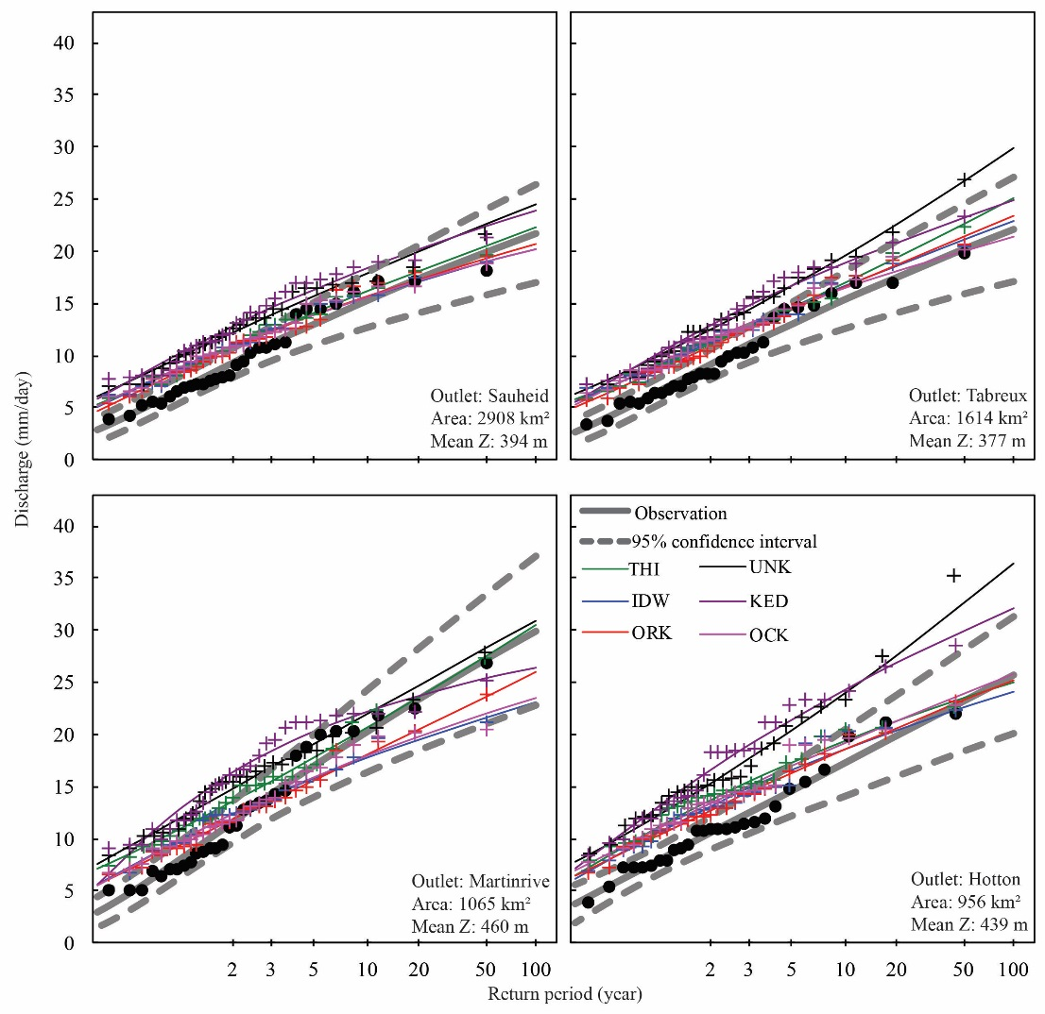
6. Extreme discharge response to geostatistical rainfall
6.3. Results and discussion
4b raingages (index=1.35)
4c raingages (index=1.50)

Slide 27
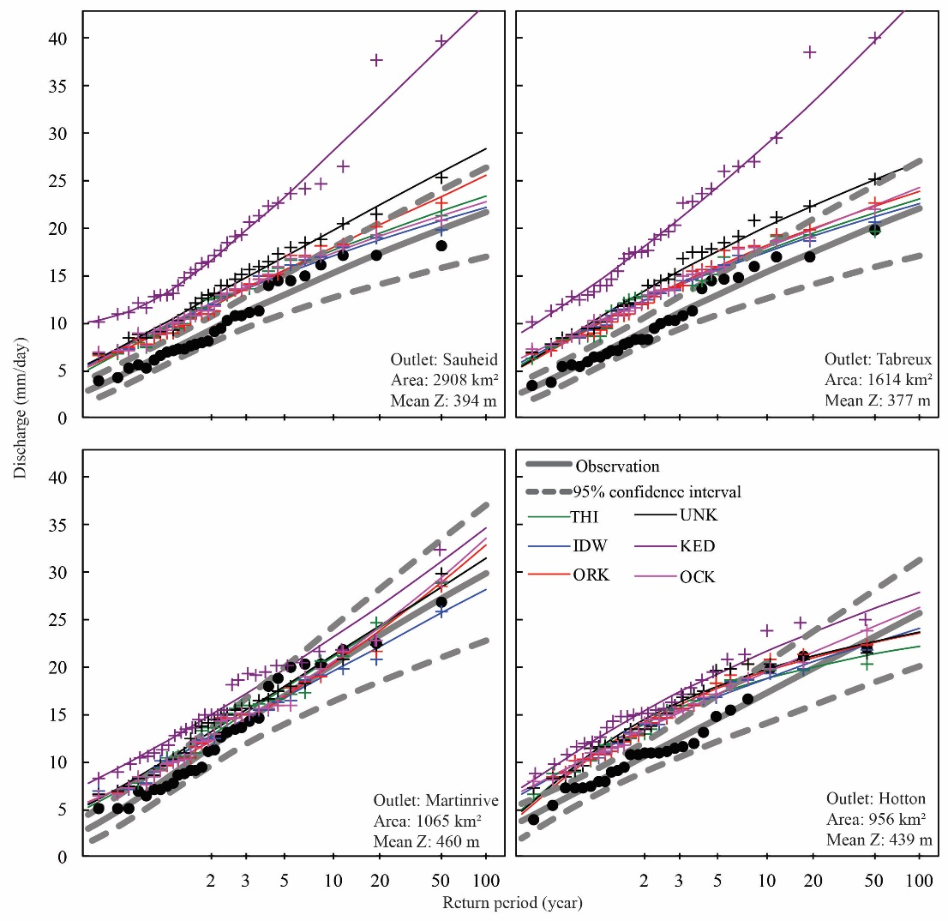
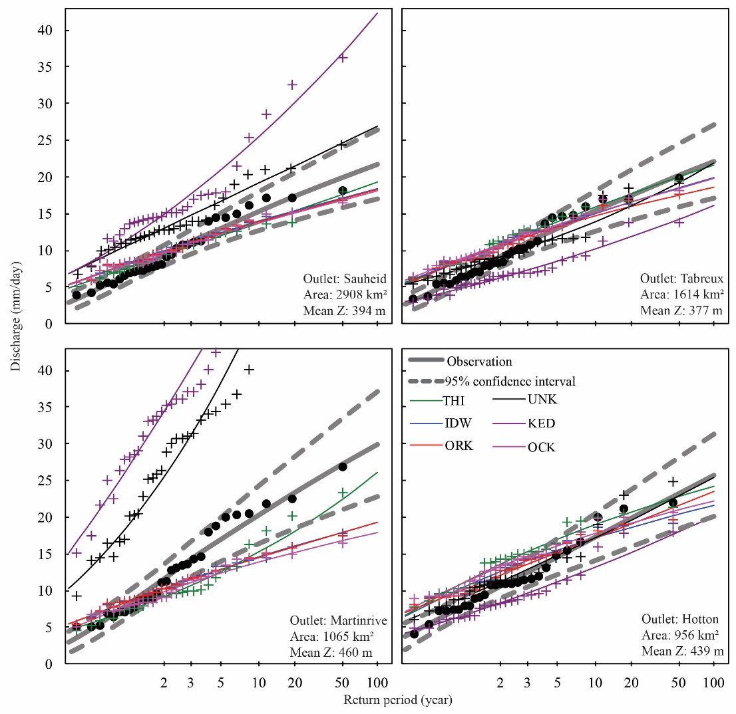
6. Extreme discharge response to geostatistical rainfall
6.3. Results and discussion
4d raingages (index=1.52)
4e raingages (index=1.61)

Slide 28
6. Extreme discharge response to geostatistical rainfall
6.4. Conclusions
IDW cannot well predict the rainfall to simulate good peak discharge when using all available raingages in the catchment area. KED and OCK can significantly recover the rainfall prediction to produce very good simulated peak discharge at high elevation sub-catchment.
For the eight raingage cases, the UNK is not very appropriate for the low elevation sub-catchment but quite good for high elevation sub-catchment. The IDW, ORK and OCK provide generally good performance. The THI and KED have the observed peak discharge and distribution very closely to the observed one for the whole catchment but they are not very suitable for sub-catchments.
Gravelius’s index can be used as a key factor to define the model’s performance. IDW, ORK and OCK distribution functions stay closer to observed one for all raingage position tested. THI, UNK and KED get worse according to increased Gravelius’s index. Especially, UNK and KED methods are the most sensitive.

